Slide 1
Probabilistic ML
CS771: Introduction to Machine Learning
Purushottam Kar

Slide 2
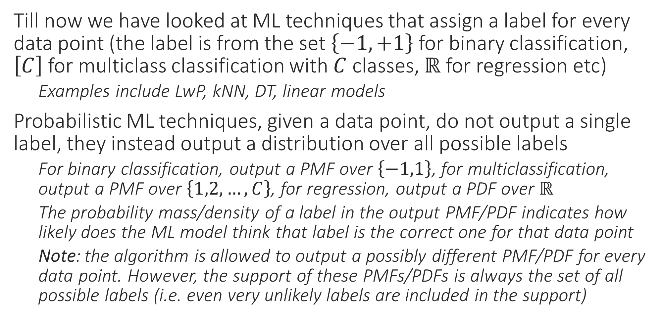
Probabilistic ML
Till now we have looked at ML techniques that assign a label for every data point (the label is from the set $\left\{−1,+1\right\}$ for binary classification, $\left[C\right]$ for multiclass classification with $C$ classes, $ℝ$ for regression etc)
Examples include LwP, kNN, DT, linear models
Probabilistic ML techniques, given a data point, do not output a single label, they instead output a distribution over all possible labels
For binary classification, output a PMF over $\left\{−1,1\right\}$, for multiclassification, output a PMF over $\left\{1,2,…,C\right\}$, for regression, output a PDF over $ℝ$
The probability mass/density of a label in the output PMF/PDF indicates how likely does the ML model think that label is the correct one for that data point
Note: the algorithm is allowed to output a possibly different PMF/PDF for every data point. However, the support of these PMFs/PDFs is always the set of all possible labels (i.e. even very unlikely labels are included in the support)

Slide 3


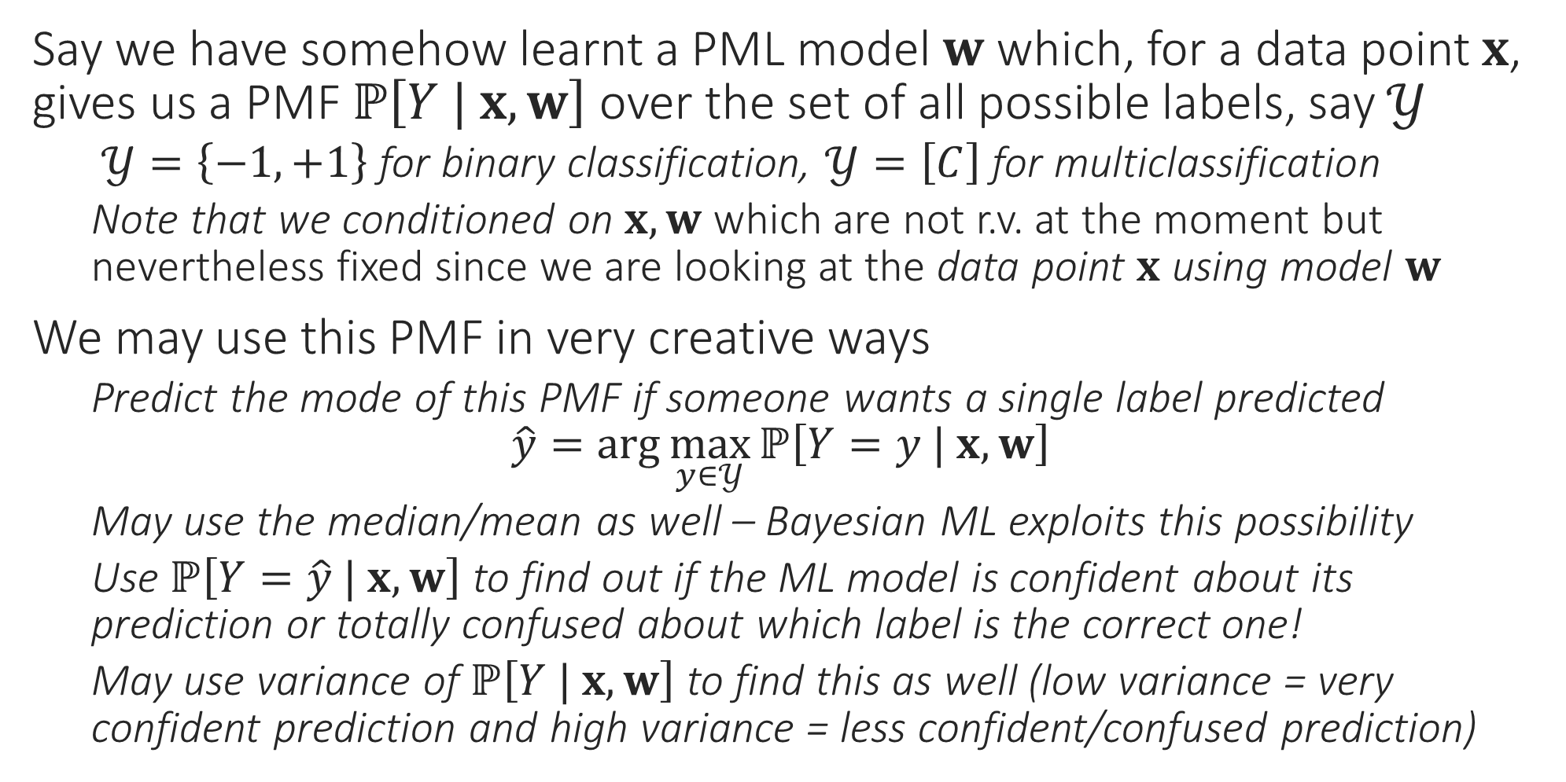
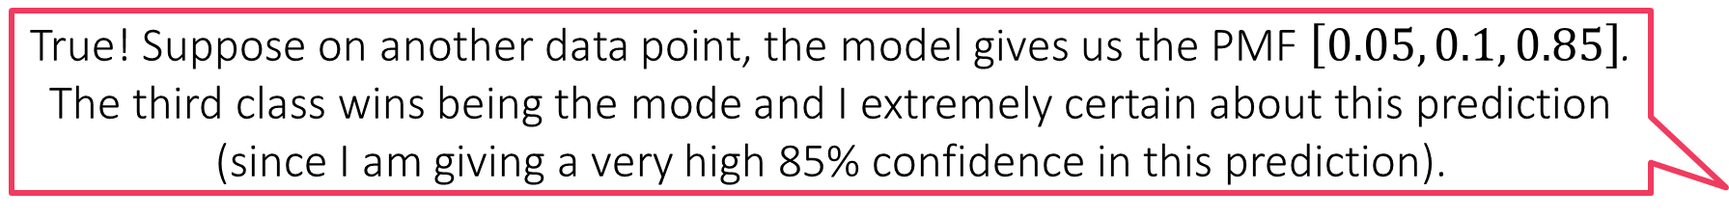
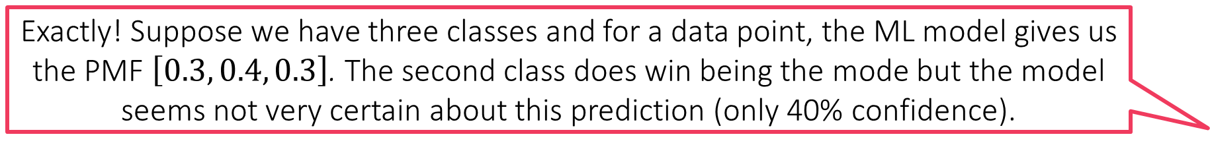
Probabilistic ML for Classification
Exactly! Suppose we have three classes and for a data point, the ML model gives us the PMF $\left[0.3, 0.4, 0.3\right]$. The second class does win being the mode but the model seems not very certain about this prediction (only 40% confidence).
Say we have somehow learnt a PML model $w$ which, for a data point $x$, gives us a PMF $ℙ\left[Y | x, w\right]$ over the set of all possible labels, say $𝒴$
$𝒴=\left\{−1,+1\right\}$ for binary classification, $𝒴=\left[C\right]$ for multiclassification
Note that we conditioned on $x, w$ which are not r.v. at the moment but nevertheless fixed since we are looking at the data point $x$ using model $w$
We may use this PMF in very creative ways
Predict the mode of this PMF if someone wants a single label predicted $\hat{y}=\arg{\max_{y∈𝒴}{ℙ\left[Y=y | x, w\right]}}$
May use the median/mean as well – Bayesian ML exploits this possibility
Use $ℙ\left[Y=\hat{y} | x, w\right]$ to find out if the ML model is confident about its prediction or totally confused about which label is the correct one!
May use variance of $ℙ\left[Y | x, w\right]$ to find this as well (low variance = very confident prediction and high variance = less confident/confused prediction)
True! Suppose on another data point, the model gives us the PMF $\left[0.05, 0.1, 0.85\right]$. The third class wins being the mode and I extremely certain about this prediction (since I am giving a very high 85% confidence in this prediction).
I could not agree more. However, in many ML applications (e.g. active learning) if we find that the model is making unsure predictions, we can switch to another model or just ask a human to step in. Thus, confidence info can be used fruitfully
Warning! Just because a prediction is made with more confidence does not mean it must be correct. It may happen that the 40% confidence prediction in the first case is correct but the high 85% confidence prediction in the second case is wrong!

Slide 4
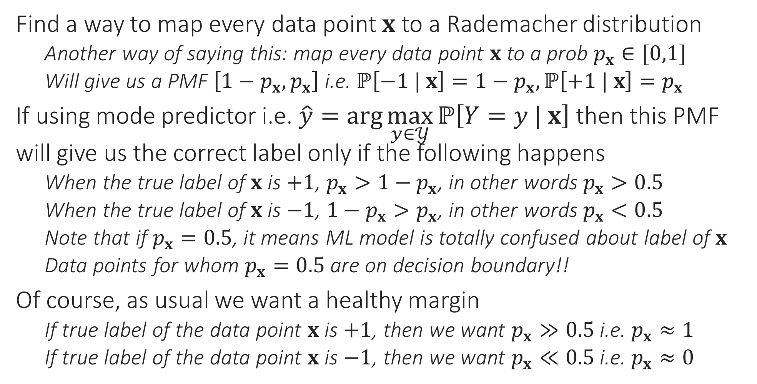
Probabilistic Binary Classification
Find a way to map every data point $x$ to a Rademacher distribution
Another way of saying this: map every data point $x$ to a prob $p_{x}∈[0,1]$
Will give us a PMF $\left[1−p_{x},p_{x}\right]$ i.e. $ℙ\left[−1 | x\right]=1−p_{x},ℙ\left[+1 | x\right]=p_{x}$
If using mode predictor i.e. $\hat{y}=\arg{\max_{y∈𝒴}{ℙ\left[Y=y | x\right]}}$ then this PMF will give us the correct label only if the following happens
When the true label of $x$ is $+1$, $p_{x}>1−p_{x}$, in other words $p_{x}>0.5$
When the true label of $x$ is $−1$, ${1−p}_{x}>p_{x}$, in other words $p_{x}<0.5$
Note that if $p_{x}=0.5$, it means ML model is totally confused about label of $x$
Data points for whom $p_{x}=0.5$ are on decision boundary!!
Of course, as usual we want a healthy margin
If true label of the data point $x$ is $+1$, then we want $p_{x}≫0.5$ i.e. $p_{x}≈1$
If true label of the data point $x$ is $−1$, then we want $p_{x}≪0.5$ i.e. $p_{x}≈0$

Slide 5


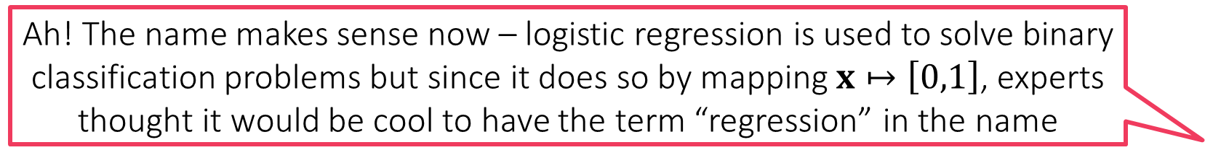
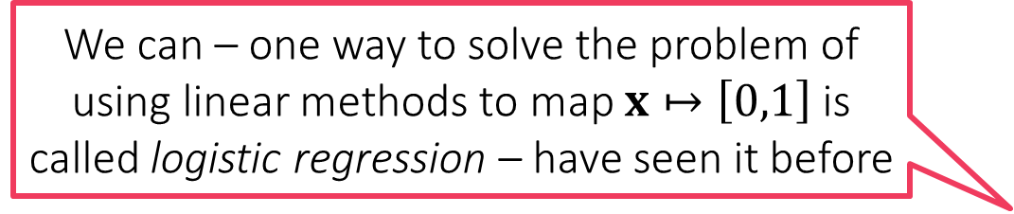
Probabilistic Binary Classification
So can we never use linear models to do probabilistic ML?
How to map feature vectors $x$ to probability values $p_{x}∈[0,1]$?
Could treat it as a regression problem since prob values $∈ℝ$ after all
Will need to modify the training set a bit to do this (basically change all $−1$ labels to $0$ since we want $p_{x}=0$ if the label is $−1$
Could use kNN, DT etc to solve this regression problem
Using linear models to do this presents a challenge
If we learn a linear model $w$ using ridge regression it may happen that for some data point $x$, we have $w^{⊤}x<0$ or else $w^{⊤}x>1$
$p_{x}$ wont make sense in this case – not a valid PMF!!
kNN, DT don’t suffer from this problem since they always predict a $p_{x}∈[0,1]$
kNN, DT use averages of a bunch of train labels to obtain test prediction – the average of a bunch of 0s and 1s is always a value in the range $\left[0,1\right]$
We can – one way to solve the problem of using linear methods to map $x↦\left[0,1\right]$ is called logistic regression – have seen it before
Yes, but there is a trick involved. Let us take a look at it
Ah! The name makes sense now – logistic regression is used to solve binary classification problems but since it does so by mapping $x↦\left[0,1\right]$, experts thought it would be cool to have the term “regression” in the name

Slide 6

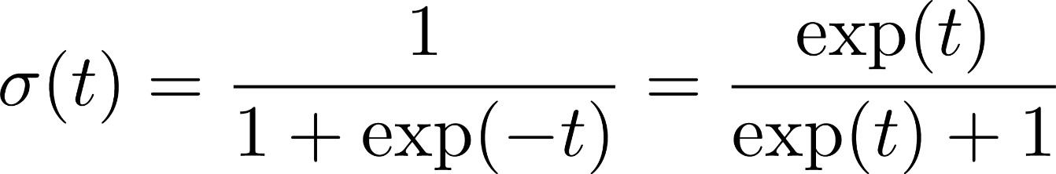
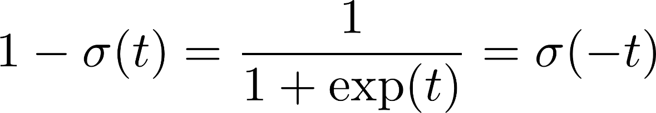
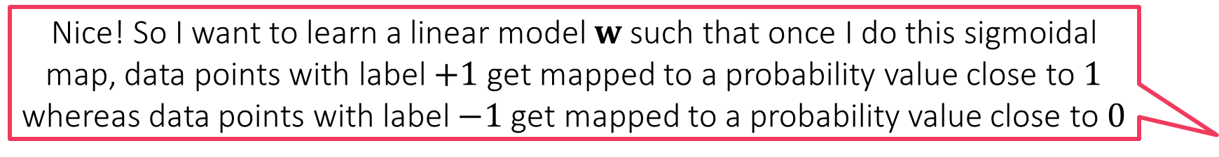
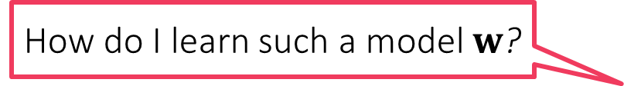
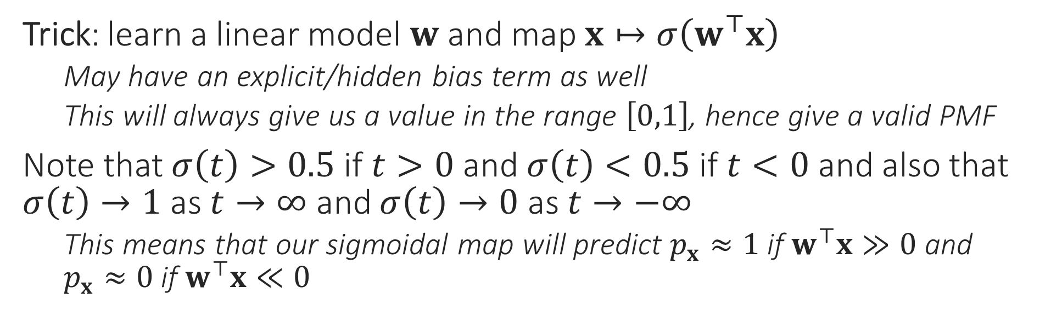
Sigmoid Function
Nice! So I want to learn a linear model $w$ such that once I do this sigmoidal map, data points with label $+1$ get mapped to a probability value close to $1$ whereas data points with label $−1$ get mapped to a probability value close to $0$
1
0.5
There are several other such wrapper/quashing/link/activation functions which do similar jobs e.g. tanh, ramp, ReLU
0
Trick: learn a linear model $w$ and map $x↦σ\left(w^{⊤}x\right)$
May have an explicit/hidden bias term as well
This will always give us a value in the range $\left[0,1\right]$, hence give a valid PMF
Note that $σ\left(t\right)>0.5$ if $t>0$ and $σ\left(t\right)<0.5$ if $t<0$ and also that $σ\left(t\right)→1$ as $t→∞$ and $σ\left(t\right)→0$ as $t→−∞$
This means that our sigmoidal map will predict $p_{x}≈1$ if $w^{⊤}x≫0$ and $p_{x}≈0$ if $w^{⊤}x≪0$
How do I learn such a model $w$?

Slide 7
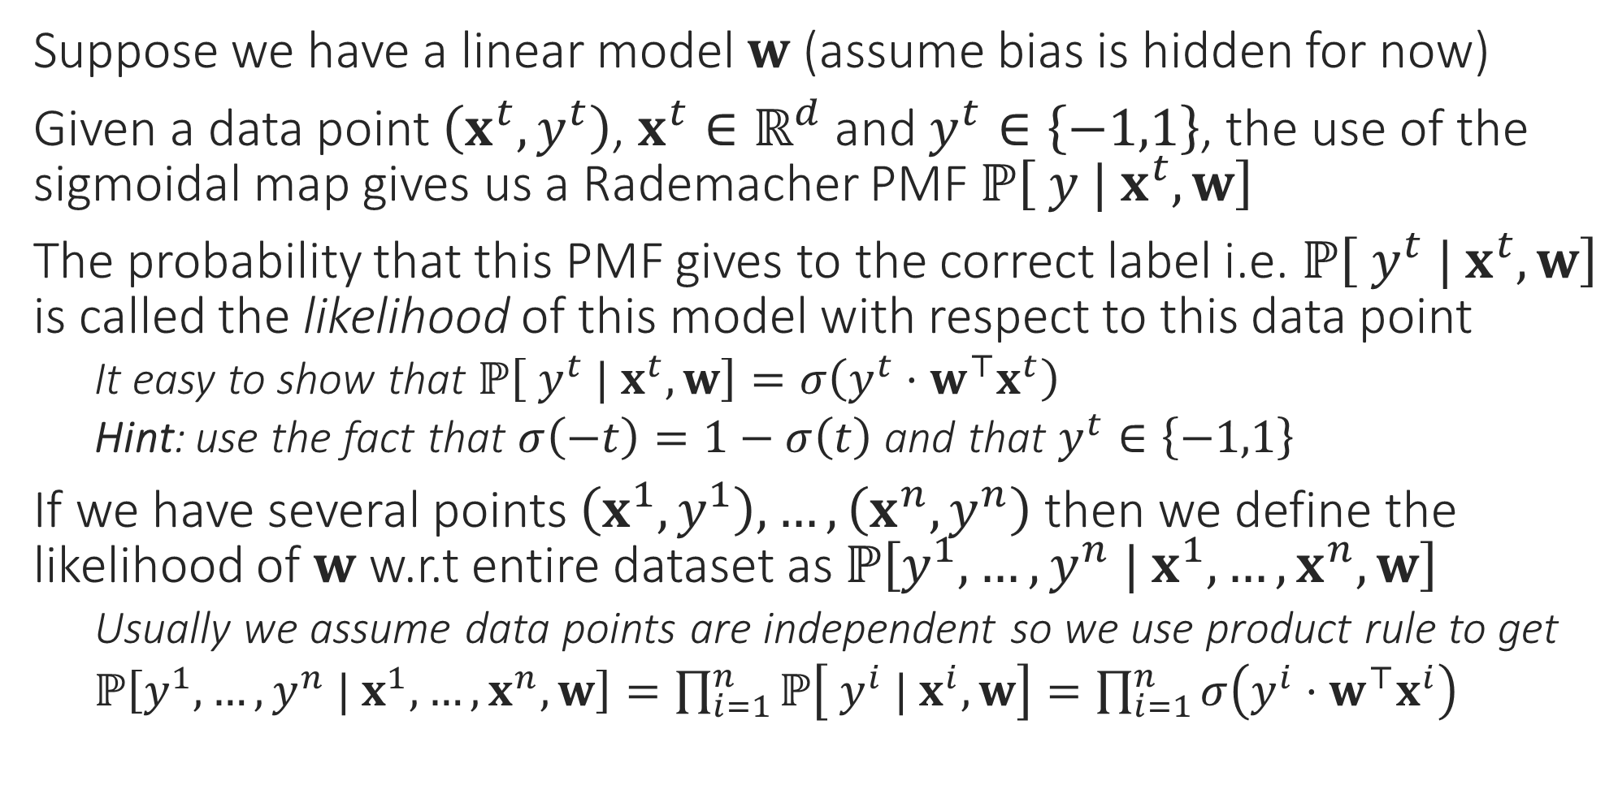
Likelihood
Data might not actually be independent e.g. my visiting a website may not be independent from my friend visiting the same website if I have found an offer on that website and posted about it on social website. However, often we nevertheless assume independence to make life simple
Suppose we have a linear model $w$ (assume bias is hidden for now)
Given a data point $\left(x^{t},y^{t}\right)$, $x^{t}∈ℝ^{d}$ and $y^{t}∈\left\{−1,1\right\}$, the use of the sigmoidal map gives us a Rademacher PMF $ℙ\left[ y | x^{t},w\right]$
The probability that this PMF gives to the correct label i.e. $ℙ\left[ y^{t} | x^{t},w\right]$ is called the likelihood of this model with respect to this data point
It easy to show that $ℙ\left[ y^{t} | x^{t},w\right]=σ\left(y^{t}⋅w^{⊤}x^{t}\right)$
Hint: use the fact that $σ\left(−t\right)=1−σ\left(t\right)$ and that $y^{t}∈\left\{−1,1\right\}$
If we have several points $\left(x^{1},y^{1}\right),…,\left(x^{n},y^{n}\right)$ then we define the likelihood of $w$ w.r.t entire dataset as $ℙ\left[y^{1},…,y^{n} | x^{1},…,x^{n},w\right]$
Usually we assume data points are independent so we use product rule to get
$ℙ\left[y^{1},…,y^{n} | x^{1},…,x^{n},w\right]=\prod_{i=1}^{n}{ℙ\left[ y^{i} | x^{i},w\right]}=\prod_{i=1}^{n}{σ\left(y^{i}⋅w^{⊤}x^{i}\right)}$

Slide 8
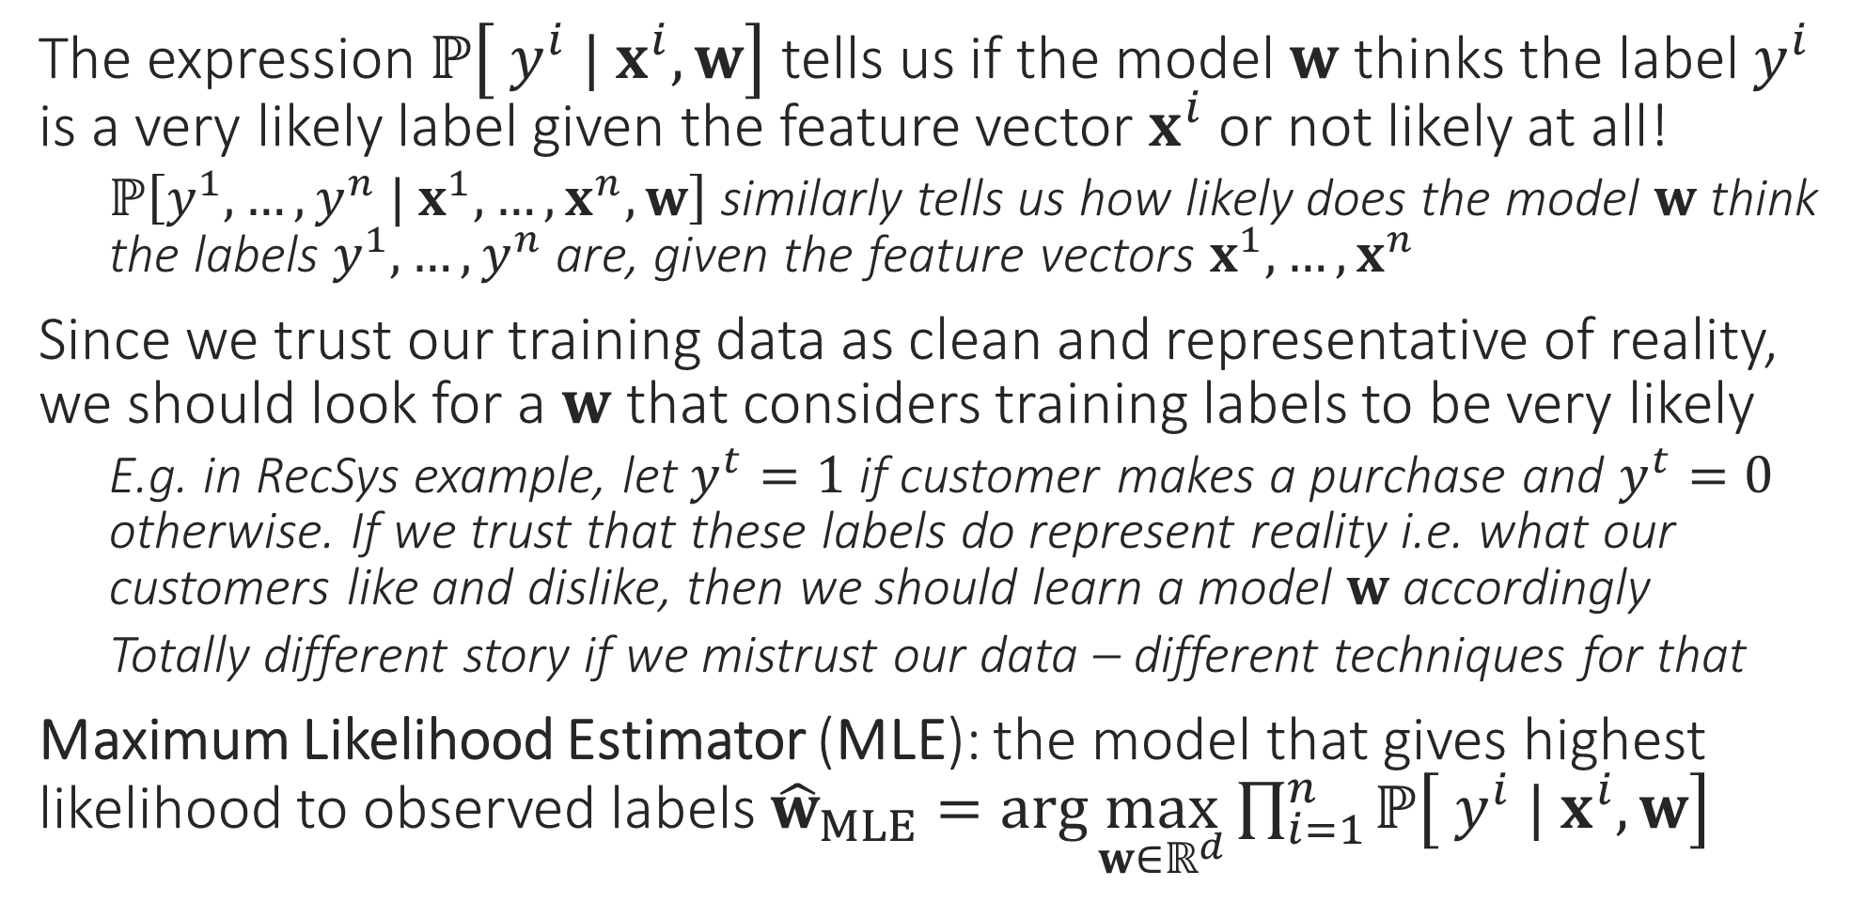
Maximum Likelihood
The expression $ℙ\left[ y^{i} | x^{i},w\right]$ tells us if the model $w$ thinks the label $y^{i}$ is a very likely label given the feature vector $x^{i}$ or not likely at all!
$ℙ\left[y^{1},…,y^{n} | x^{1},…,x^{n},w\right]$ similarly tells us how likely does the model $w$ think the labels $y^{1},…,y^{n}$ are, given the feature vectors $x^{1},…,x^{n}$
Since we trust our training data as clean and representative of reality, we should look for a $w$ that considers training labels to be very likely
E.g. in RecSys example, let $y^{t}=1$ if customer makes a purchase and $y^{t}=0$ otherwise. If we trust that these labels do represent reality i.e. what our customers like and dislike, then we should learn a model $w$ accordingly
Totally different story if we mistrust our data – different techniques for that
Maximum Likelihood Estimator (MLE): the model that gives highest likelihood to observed labels ${\hat{w}}_{MLE}=\arg{\max_{w∈ℝ^{d}}{\prod_{i=1}^{n}{ℙ\left[ y^{i} | x^{i},w\right]}}}$

Slide 9
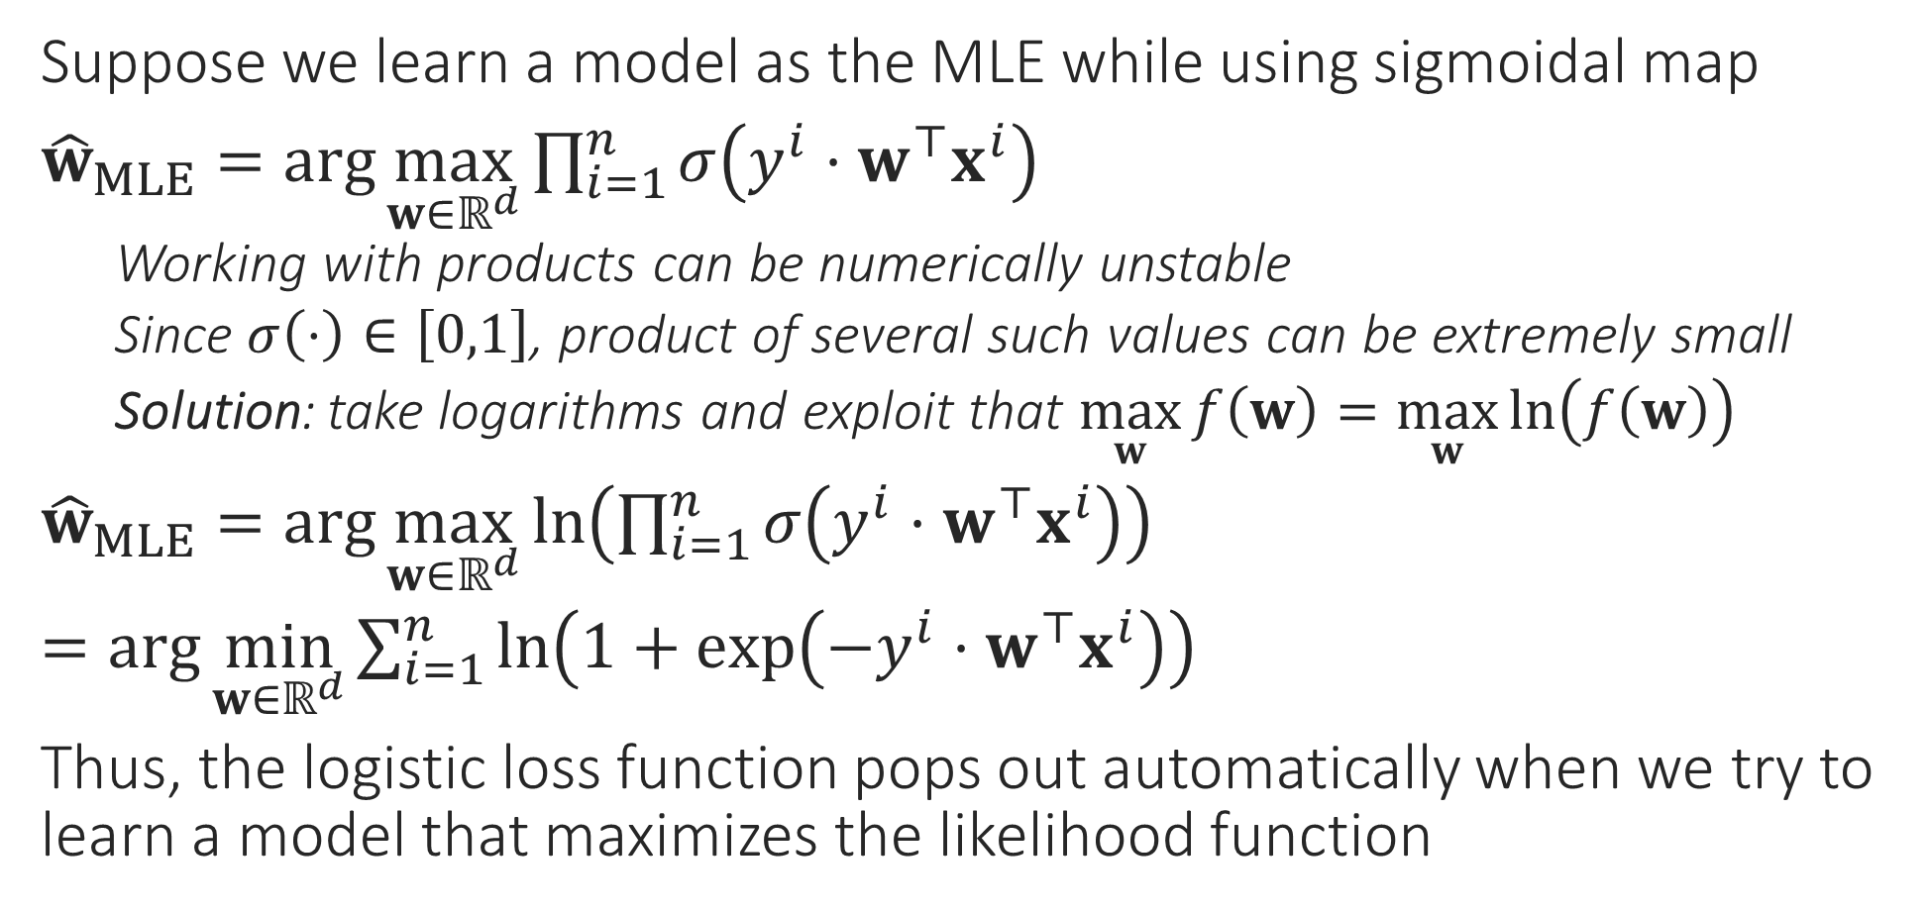
Logistic Regression
Suppose we learn a model as the MLE while using sigmoidal map
${\hat{w}}_{MLE}=\arg{\max_{w∈ℝ^{d}}{\prod_{i=1}^{n}{σ\left(y^{i}⋅w^{⊤}x^{i}\right)}}}$
Working with products can be numerically unstable
Since $σ\left(⋅\right)∈\left[0,1\right]$, product of several such values can be extremely small
Solution: take logarithms and exploit that $\max_{w}{f\left(w\right)}=\max_{w}{\ln\left(f\left(w\right)\right)}$
${\hat{w}}_{MLE}=\arg{\max_{w∈ℝ^{d}}{\ln\left(\prod_{i=1}^{n}{σ\left(y^{i}⋅w^{⊤}x^{i}\right)}\right)}}$
$=\arg{\min_{w∈ℝ^{d}}{\sum_{i=1}^{n}{\ln\left(1+\exp\left(−y^{i}⋅w^{⊤}x^{i}\right)\right)}}}$
Thus, the logistic loss function pops out automatically when we try to learn a model that maximizes the likelihood function
Also called negative log-likelihood

Slide 10


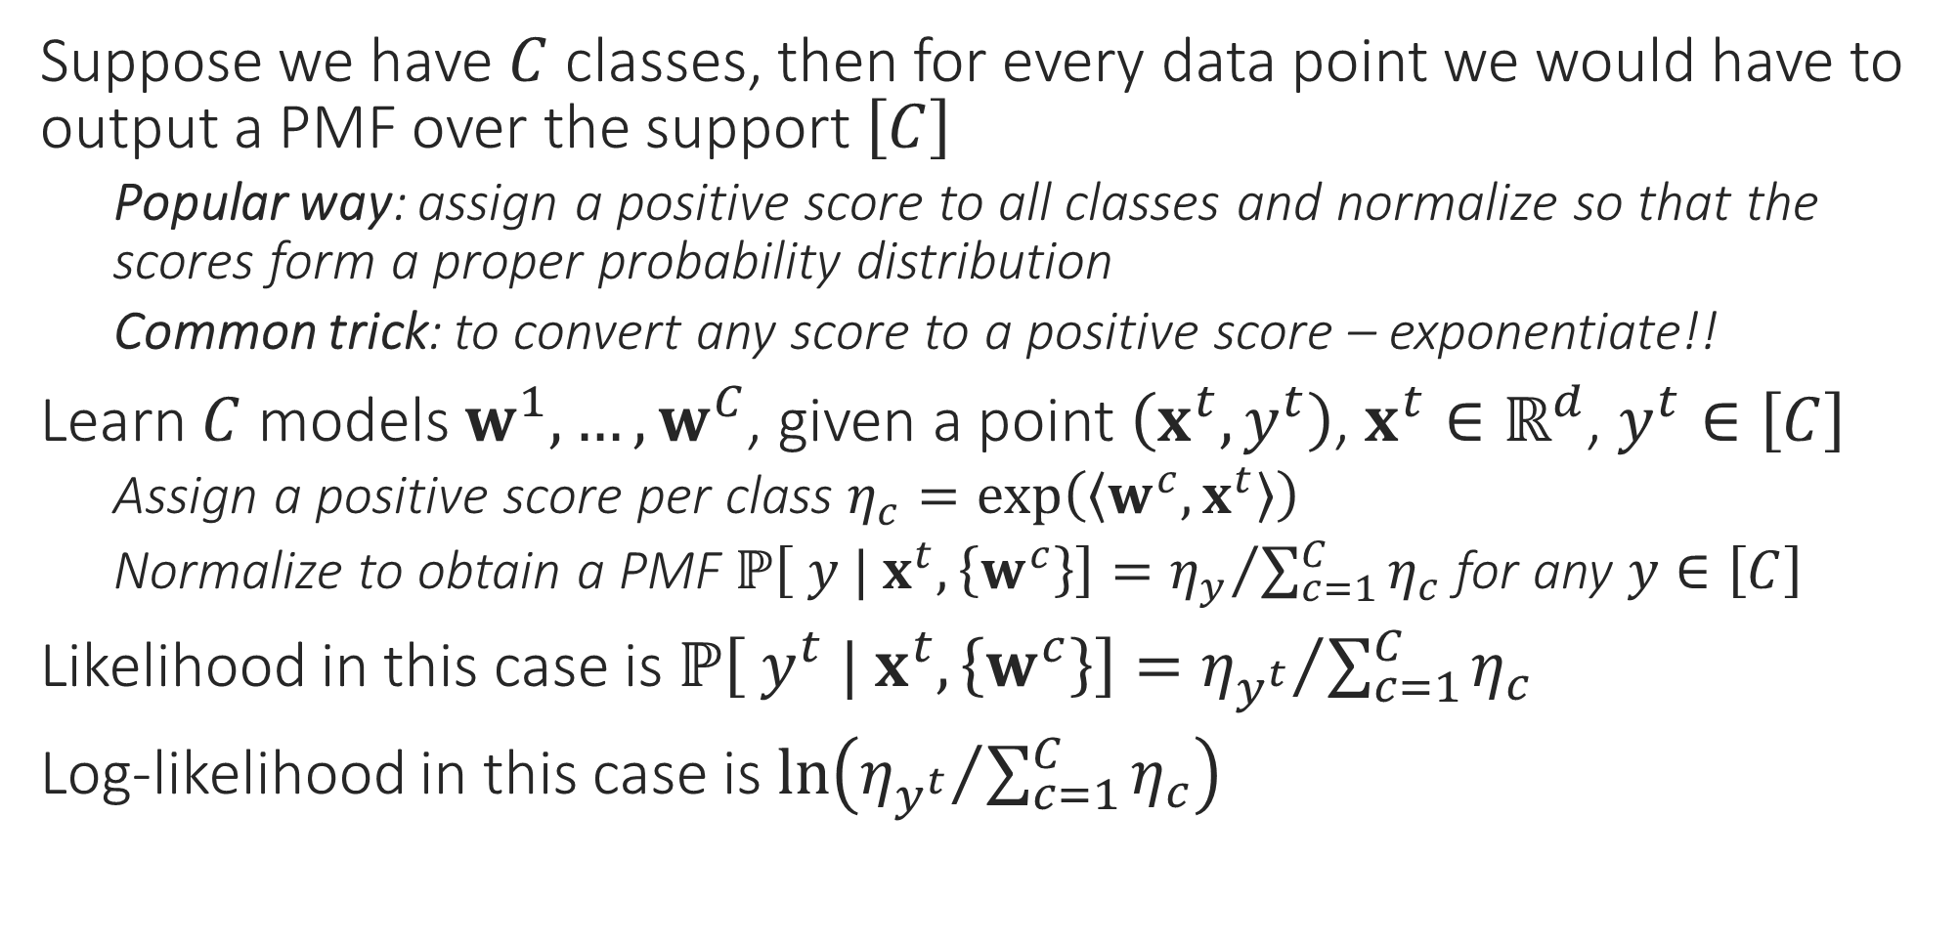
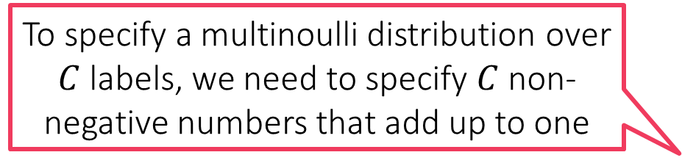
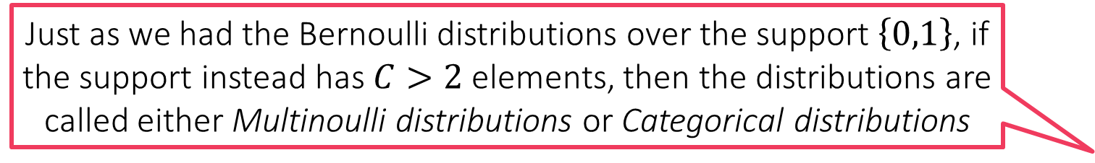
Probabilistic Multiclassification
Just as we had the Bernoulli distributions over the support $\left\{0,1\right\}$, if the support instead has $C>2$ elements, then the distributions are called either Multinoulli distributions or Categorical distributions
Suppose we have $C$ classes, then for every data point we would have to output a PMF over the support $\left[C\right]$
Popular way: assign a positive score to all classes and normalize so that the scores form a proper probability distribution
Common trick: to convert any score to a positive score – exponentiate!!
Learn $C$ models $w^{1},…,w^{C}$, given a point $\left(x^{t},y^{t}\right)$, $x^{t}∈ℝ^{d}$, $y^{t}∈\left[C\right]$
Assign a positive score per class $η_{c}=\exp\left(\left\langle w^{c},x^{t}\right\rangle \right)$
Normalize to obtain a PMF $ℙ\left[ y | x^{t},\left\{w^{c}\right\}\right]={η_{y}}/{\sum_{c=1}^{C}{η_{c}}}$ for any $y∈\left[C\right]$
Likelihood in this case is $ℙ\left[ y^{t} | x^{t},\left\{w^{c}\right\}\right]={η_{y^{t}}}/{\sum_{c=1}^{C}{η_{c}}}$
Log-likelihood in this case is $\ln\left({η_{y^{t}}}/{\sum_{c=1}^{C}{η_{c}}}\right)$
To specify a multinoulli distribution over $C$ labels, we need to specify $C$ non-negative numbers that add up to one

Slide 11



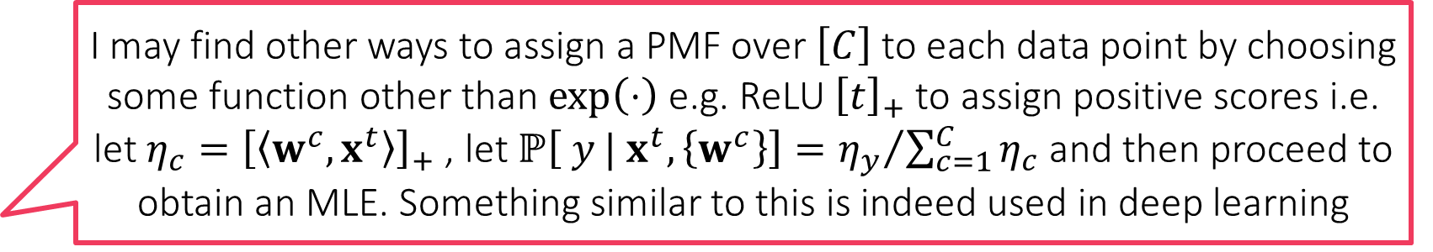
Softmax Regression
I may find other ways to assign a PMF over $\left[C\right]$ to each data point by choosing some function other than $\exp\left(⋅\right)$ e.g. ReLU ${\left[t\right]}_{+}$ to assign positive scores i.e. let $η_{c}={\left[\left\langle w^{c},x^{t}\right\rangle \right]}_{+}$ , let $ℙ\left[ y | x^{t},\left\{w^{c}\right\}\right]={η_{y}}/{\sum_{c=1}^{C}{η_{c}}}$ and then proceed to obtain an MLE. Something similar to this is indeed used in deep learning
If we now want to learn the MLE, we would have to find
$\left\{{\hat{w}}_{MLE}^{1},…,{\hat{w}}_{MLE}^{C}\right\}=\arg{\max_{w^{1},…,w^{C}∈ℝ^{d}}{\prod_{i=1}^{n}{ℙ\left[ y^{i} | x^{i},w\right]}}}$
$=\arg{\max_{w^{1},…,w^{C}∈ℝ^{d}}{\prod_{i=1}^{n}{{η_{y^{t}}^{i}}/{\sum_{c=1}^{C}{η_{c}^{i}}}}}}$ where $η_{c}^{i}=\exp\left(\left\langle w^{c},x^{i}\right\rangle \right)$
Using the negative log-likelihood for numerical stability
$=\arg{\min_{w^{1},…,w^{C}∈ℝ^{d}}{\sum_{i=1}^{n}{−\ln\left({η_{y^{t}}^{i}}/{\sum_{c=1}^{C}{η_{c}^{i}}}\right)}}}$
Note: this is nothing but the softmax loss function we saw earlier, also known as the cross entropy loss function
Reason for the name: it corresponds to something known as the cross entropy between the PMF given by the model and the true label of the data point
It should be noted that this is not the only way to do probabilistic multiclassification. It is just that this way is simple to understand, implement and hence popular
However, be warned that generating a PMF using DT/kNN need not necessarily be an MLE since we have not explicitly maximized any likelihood function here
I could do also kNN or DT and invoke the “probability as proportions” interpretation to assign a test data point to a PMF that simply gives the proportion of each label in the neighbourhood/leaf of that data point!!

Slide 12
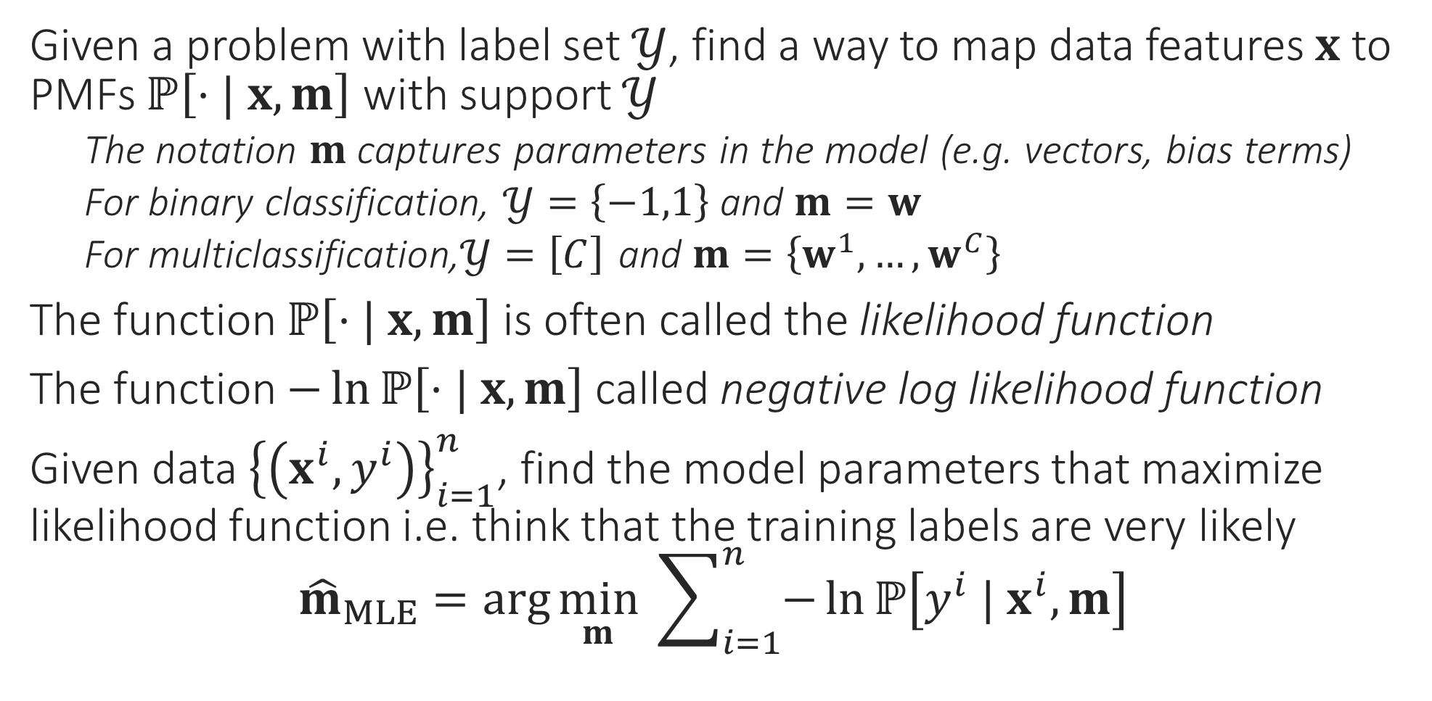
General Recipe for MLE Algorithms
Given a problem with label set $𝒴$, find a way to map data features $x$ to PMFs $ℙ\left[⋅| x, m\right]$ with support $𝒴$
The notation $m$ captures parameters in the model (e.g. vectors, bias terms)
For binary classification, $𝒴=\left\{−1,1\right\}$ and $m=w$
For multiclassification,$𝒴=\left[C\right]$ and $m=\left\{w^{1},…,w^{C}\right\}$
The function $ℙ\left[⋅| x, m\right]$ is often called the likelihood function
The function $−\ln{ℙ\left[⋅| x, m\right]}$ called negative log likelihood function
Given data ${\left\{\left(x^{i},y^{i}\right)\right\}}_{i=1}^{n}$, find the model parameters that maximize likelihood function i.e. think that the training labels are very likely ${\hat{m}}_{MLE}=\arg{\min_{m}{ \sum_{i=1}^{n}{−\ln{ℙ\left[y^{i} | x^{i}, m\right]}}}}$

Slide 13


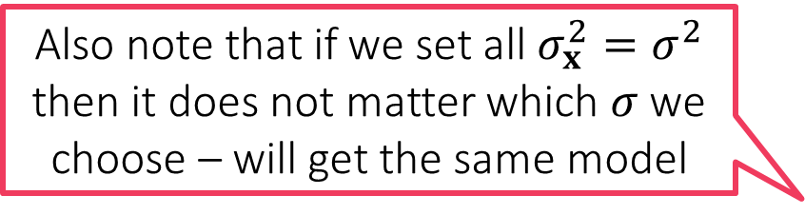
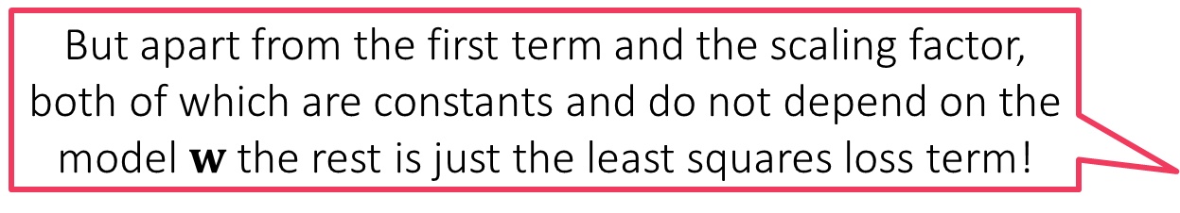
Probabilistic Regression
But apart from the first term and the scaling factor, both of which are constants and do not depend on the model $w$ the rest is just the least squares loss term!
In order to perform probabilistic regression I have to assign a label distribution over all $ℝ$ for every data point $x$ using a PDF
Suppose I decide to do that using a Gaussian distribution – need to decide on a mean $μ_{x}$ and a variance $σ_{x}^{2}>0$
Popular choice: Let $μ_{x}=w^{⊤}x$ and $σ_{x}^{2}=σ^{2}$ i.e. $𝒩\left(⋅| w^{⊤}x,σ^{2}\right)$
We can also choose a different $σ$ for every data point – more complicated
Likelihood function w.r.t a data point $\left(x^{i},y^{i}\right)$ then becomes $𝒩\left(y^{i} | w^{⊤}x^{i},σ^{2}\right)=\frac{1}{\sqrt{2πσ^{2}}}\exp\left(−{\left(y^{i}−w^{⊤}x^{i}\right)}^{2}/{2σ}^{2}\right)$
Negative log likelihood w.r.t a set of data points ${\left\{\left(x^{i},y^{i}\right)\right\}}_{i=1}^{n}$ $\frac{n}{2}ln\left(2πσ^{2}\right)+\frac{1}{2σ^{2}}\sum_{i=1}^{n}{{\left(y^{i}−w^{⊤}x^{i}\right)}^{2}}$
The MLE with respect to the Gaussian likelihood indeed the minimizes least squares loss
Also note that if we set all $σ_{x}^{2}=σ^{2}$ then it does not matter which $σ$ we choose – will get the same model
$$\min_{w∈ℝ^{d}}{}$$

Slide 14

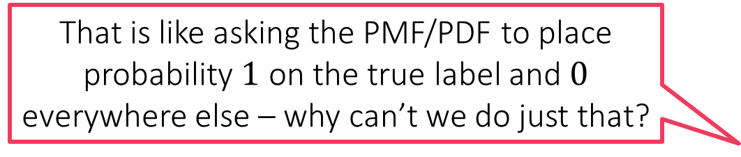
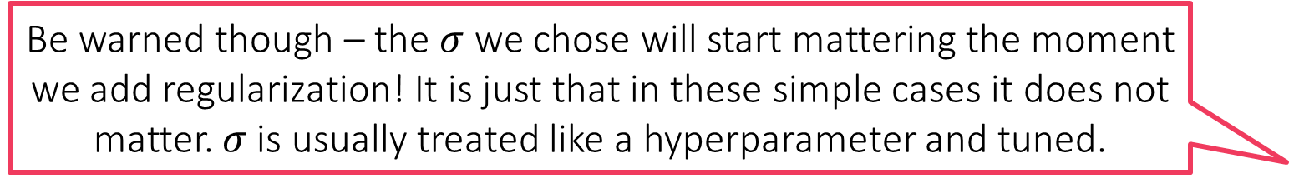

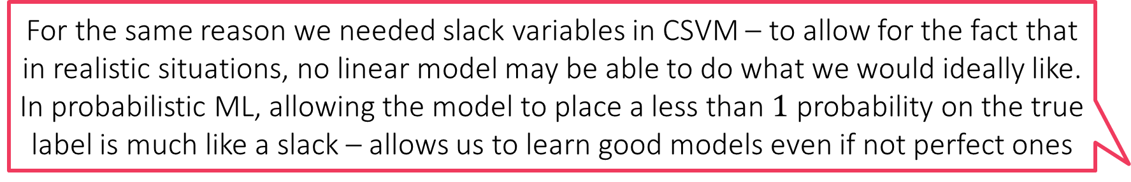
Probabilistic Regression
Be warned though – the $σ$ we chose will start mattering the moment we add regularization! It is just that in these simple cases it does not matter. $σ$ is usually treated like a hyperparameter and tuned.
Suppose I decide to use a Laplacian distribution instead and choose $μ_{x}=w^{⊤}x$ and $σ_{x}=σ$ i.e. $Lap\left(⋅| w^{⊤}x,σ\right)$
Likelihood function w.r.t a data point $\left(x^{i},y^{i}\right)$ then becomes $Lap\left(y^{i} | w^{⊤}x^{i},σ\right)=\frac{1}{2σ}\exp\left(−\left|y^{i}−w^{⊤}x\right|/σ\right)$
Negative log likelihood w.r.t a set of data points ${\left\{\left(x^{i},y^{i}\right)\right\}}_{i=1}^{n}$ $\min_{w∈ℝ^{d}}{ n⋅ln\left(σ\right)+\frac{1}{σ}\sum_{i=1}^{n}{\left|y^{i}−w^{⊤}x^{i}\right|}}=\min_{w∈ℝ^{d}}{ \sum_{i=1}^{n}{\left|y^{i}−w^{⊤}x^{i}\right|}}$
Thus, if we change the likelihood function to use the Laplacian distribution instead, the MLE ends up minimizing absolute loss!
As before, does not matter which $σ$ we choose
So I am a bit confused. All MLEs (classification/regression) demand a model that places maximum probability on the true label. Why don’t we just ask the model to predict the true label itself?
That is like asking the PMF/PDF to place probability $1$ on the true label and $0$ everywhere else – why can’t we do just that?
For the same reason we needed slack variables in CSVM – to allow for the fact that in realistic situations, no linear model may be able to do what we would ideally like. In probabilistic ML, allowing the model to place a less than $1$ probability on the true label is much like a slack – allows us to learn good models even if not perfect ones

Slide 15
Probabilistic Regularization??
We have seen that MLE often reduces to loss minimization e.g. logistic regression/least squares regression but without regularization terms ☹
Even probabilistic methods can do regularization by way of priors
Recall: regularization basically tells us which kinds of models we prefer
L2 regularization means we prefer models with small L2 norm
L1 regularization means we prefer models with small L1 norm/sparse models
In the language of probability, the most direct way of specifying such a preference is by specifying a probability distribution itself
Prior: a probability distribution over all possible models
Just like we usually decide regularization before seeing any data, prior distribution also does not consider/condition on, any data
But our models are vectors right? Can we have probability distribution over vectors as well?
Of course we can. But first, let us see the basic operations in a toy 1D setting before getting into the complications of vector-valued r.v.s

